Slide 1
Your Colour Energy Mix
Cautious
Precise
Deliberate
Questioning
Formal
Competitive
Demanding
Determined
Strong-willed
Purposeful
Caring
Encouraging
Sharing
Patient
Relaxed
Sociable
Dynamic
Demonstrative
Enthusiastic
Persuasive
Notes:
Provide a balanced view of each colour energy and give equal air time to the good and bad day description of each colour energy - help your participants find their style through your descriptions.
Bring the colour energies to life, both in the words you choose, and how you might
demonstrate the energy as you describe it. Remember to walk the fine balance
of demonstrating, without over-simplifying or making colour energy caricatures.

Slide 2
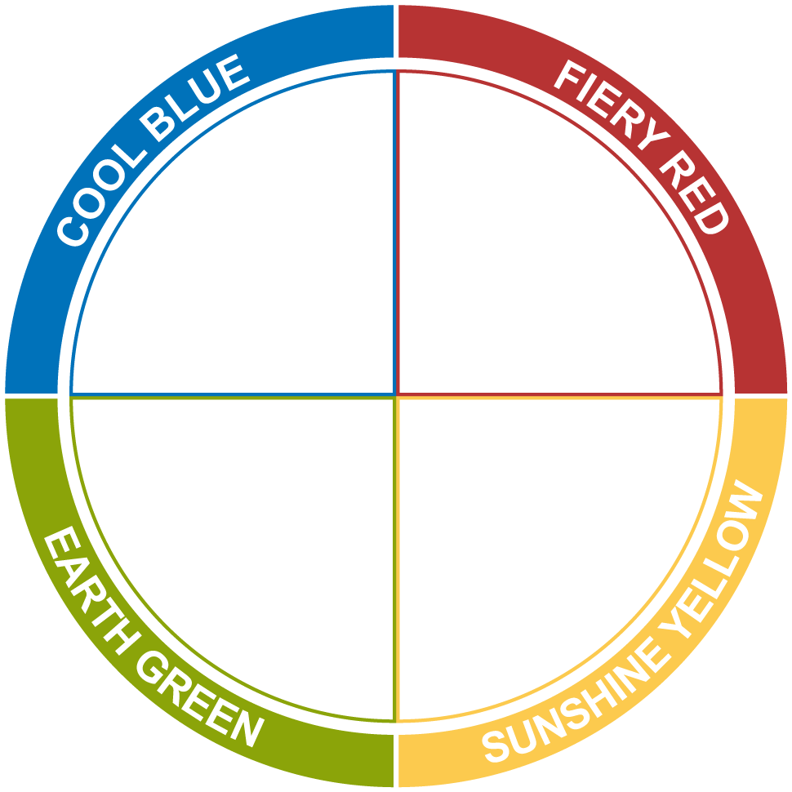
When communication with:
Cool Blue
Fiery Red
Be well prepared and thorough
Be direct and to the point
Do not be flippant on important issues
Do not hesitate or waffle
Do not push them to make quick decisions
Do not tie them down with routine
Be patient and supportive
Be friendly and sociable
Earth Green
Sunshine Yellow

Slide 3
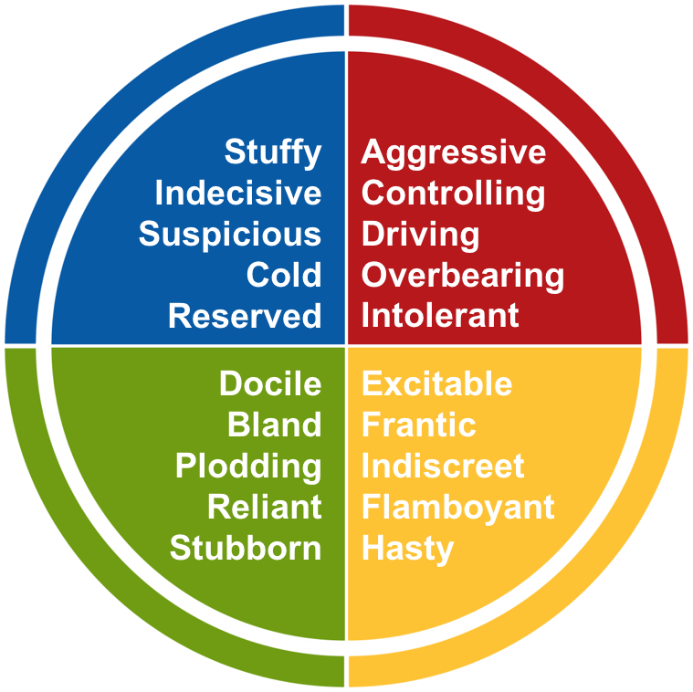
Bad Day

Slide 4
Preparing for Meetings
Cool Blue
Fiery Red
Send agenda in advance
Determine required delivery method (phone, online, face-to-face)
Provide documents to be reviewed in advance with sufficient time to review
Include short agenda with desired outcomes in meeting request
Send out action items required to prepare
Make space to discuss business plans, strategy, vision, actions in progress, etc.
Gather input on agenda items based on group needs
Rotate meeting facilitators, timekeepers and scribes
Make space in the agenda for relevant team or personnel items
Build some flexibility into the agenda for conversations that may ‘come up’
Have face-to-face meetings where possible
Allow time for team-based activities and engaging conversations
Earth Green
Sunshine Yellow

Slide 5
Facilitating Meetings
Cool Blue
Fiery Red
Start on time
Review agenda and objectives for the meeting
Assign timekeeper and scribe (if applicable)
Do a process check at end
Stay on task and stick to allocated times
If not possible, shift agenda and notify the group
Drive to tangible action where possible and close conversations when appropriate
Be considerate of different styles and aim to meet the participants differing needs
Agree meeting ground rules and refer to often
Give reflection time
Allow time for connecting with one another and socialising
Share success stories and lessons learned
Engage meeting participants where possible through questions and discussion
Earth Green
Sunshine Yellow

